Slide 1
Sing, Sing, Sing! Book 2 “Moving On Up”

Slide 2
Sing Sing Sing!
A progressive Singing Scheme from Hertfordshire Music Service’s Primary Music Team.
Singing is great, and we do it for lots of reasons; there are songs from different times and places, songs in different languages which offer us a flavour of a range of cultures, and a whole host of styles and genres. We use it to make music together, to learn about something, to come together, to express our emotions and to celebrate.
We know that singing has many benefits. But what about Progression in Singing, the actual learning how to sing?
We progress through:
Quality (doing something better and with more attention to detail)
Demand (being able to tackle harder things)
Range (widening our knowledge and repertoire)
Progression through Quality and Demand depend on us using material at the correct level for children to be able to have the most success.

Slide 3
All songs help us to expand our range, but which songs actually help us to learn to sing and to improve it, to pitch-match, to use vowels to make and carry sound and consonants to carry meaning? To use rhythm and phrase to convey the emotion and message of a song? To use dynamics to really light up a performance?
Looking at song books it can be difficult to work out which songs to chose to allow children’s voices to develop systematically and naturally, with attention to detail and satisfaction of a good job done.
This is where Sing Sing Sing! comes in. Think of it as a Reading Scheme for singing where all the work on selecting material for progression has been done for you.
This doesn’t mean that you can’t sing any other songs - far from it! Having a singing ‘scheme’ will allow you to use other songs for all the purposes you need. Just as using a Reading Scheme it doesn’t mean we deny children access to other books - think of those other songs as Library Books to enhance our pleasure and enjoyment of singing!

Slide 4
Sing, Sing, Sing! comes in 3 ‘e-books’:
Off We Go for Years 1 and 2
Moving On Up for Years 3 and 4
Aim Even Higher for Years 5 and 6
Each ‘book’ has around 20 songs which can be spread across the two school years they are designed for. They are mostly short, allowing you to concentrate on quality rather than quantity. There are no lengthy words to learn; everything has been chosen for a musical purpose and there is room for repetition and consolidation to build the children’s confidence and familiarity.

Slide 5
They are designed to be used in classrooms, projected onto boards, with the musical notation visible as well as the words. We know that children can become familiar with musical notation by being exposed to it little and often, and that they begin to identify melodic shape and rhythmic features this way. Features of notation can be pointed out as you learn.
All you need is there, and there are teacher notes to support the learning. We have chosen these songs because we know children love them, as well as developing their singing skills, and we hope that you will enjoy singing them with your class.
The HMS Primary Music Team

Slide 6
Moving on up!
This pack is designed to support teachers and all adults working with children in years three and four. We have chosen simple songs with actions – no music reading is required, nor instrumental accompaniment needed. The audio examples are for reference only; to help you to remember the songs.
The pack also refers to cross-curricular links to enrich and enhance your Creative Curriculum, with a range of activities to suit all learning styles.

Slide 7
The Benefits of Singing
Singing is soothing, spontaneous and stress-busting, raising self-esteem, boosting immune systems and improving brain power.
Short ‘bursts’ of singing activity can be fitted in during the school day as ‘brain breaks’ – it is not always necessary to set aside specific stretches of time.

Slide 8
Setting the Expectation
Children need help to find their singing voice. When they show accurate pitch matching, shower them with praise at this important developmental milestone.
Quiet singing and ‘smiling eyes’ help to achieve accuracy of pitch.
Be rigorous in helping them to achieve beautiful, unforced singing voices and do not accept anything else.
Aim to be a good role model, encouraging other adults to do the same.
Establish a good singing body
Stand feet slightly apart, relaxed shoulders, arms loosely by side
If chairs are available, establish a ‘singing seat’ position, sitting away from the back of the chair, feet tucked slightly underneath, feet together and hands flat on lap.
Wherever possible avoid sitting on the floor.

Slide 9
Skills Progression
Like numeracy and literacy, children need ‘musical building blocks’, only making effective progress if the basic skills are in place. That is why we have deliberately chosen easy songs with a narrow range of pitches.
At the start of the pack, the songs are chants or have two pitches.
If the children can sing these they will progress more easily to later songs. At the start make sure the children can find their singing voices and a steady pulse.
Distinguishing speaking and singing voices
Finding the pulse
Pitch matching
Individual singing
Awareness of phrase
Rhythm and duration (including rests)
Rhythm and pulse
Using the thinking voice
Comparatives [faster/slower/louder/quieter/higher/lower]
Please refer to our Singing Skill Progression Document for further information and detail.

Slide 10
Pitch Progression
Once children can hear and feel the difference between their speaking and singing voice, it is possible to introduce two pitches, “so” and “mi”.
This minor third interval sounds like a “cuckoo”. It is the most instinctive interval for children to sing in any culture. This “so-mi” TONESET must be established before you attempt anything more complex.
The songs in this presentation start from this tone set and progress to the PENTATONE of l-s-m-r-d.
i.e. s-m -> l-s-m -> m-r-d -> l-s-m-r-d
In selecting any songs you use, always bear this progression in mind. Some songs may also have more challenging lyrical content or tempo and therefore may be more appropriate for older children.
Young children’s voices are at their best if kept within their natural range or Middle C to the B above.
Please refer to our Singing Skill Progression Document for further information and detail.

Slide 11
How to Teach a Song
Establish a visual ‘my turn, your turn’ system
Sing the whole song (or just the first verse) through TWICE
If the song has four phrases, sing phrase one, then children copy, then sing phrase two, then children copy etc.
Then sing through phrases one and two before the copy
Repeat the process for phrases three and four.
All sing the whole song, starting with a sung “Off we go”
NOW the children should sing the song without any adult assistance, choosing a child as the “Off we go” song leader.
This method of teaching a song reinforces highly focussed listening.

Slide 12
How to Teach a Song cont.
DDW = “Don’t do it with them”
Try to resist singing along with the children all the time.
This can lead to an over-reliance on the teacher and it is important to listen to the children to assess their progress and achievement.

Slide 13
Other Activities
Get the children to choose a song they know well and:
Find the pulse
Tap the rhythm pattern
Sing some sections aloud, some in ‘thinking voice’
Sing the songs higher or lower (pitch)
Sing the songs faster or slower (tempo)
Sing the songs louder or quieter (dynamics)
Show the phrases with ‘Rainbow Arms’
Rehearse the songs in pairs or small groups to share with the class
Once everyone is confident, move on to simple part-singing, combining some of the songs as ‘partner songs:
Try combining Dads with Bounce High; and Chest, Knee, Toe with All ‘Round the Brickyard. Eventually, you can fit all four songs together!

Slide 14
How to download the audio files…
In order to keep the power point files small we have not embedded the audio files; they can be located by following the following link:
hertsmusicservice.org.uk/songpacktwo
To download the track(s) click on the download icon (hover the mouse over the track name to see it) and save in your chosen location. You will need to create a Soundcloud account to download files.
To embed into the slideshow simply drag and drop from your chosen folder onto the relevant slide and resize/reposition as required.
Alternatively you can play them directly from your chosen folder or stream them each time you use them if you prefer.

Slide 15
The Songs
Eenie Meenie A chant – diction (pronunciation), tempo changes
Dean Bon Bean Keeping a steady pulse, diction, hand-clapping game, 3 beats in a bar
Cinderella Quavers and semiquavers
Dads Lads, Girls Mums Pulse, taking turns and coming in at the correct time
Bounce High, Bounce Low Reinforcing keeping a pulse, can be paired with other songs
Have You Ever? Diction, use of thinking voice, breath control
Everywhere We Go 6/8 time signature (compound time)
D’you Want A Choc’late Ice Sir? Call and response, 6/8 time signature
High, Low, Chickalow Partner song, hand-clapping, thinking voice
Chest, Chest, Knee, Toe Thinking voice/can be paired with other songs
All ‘Round the brickyard Dotted rhythms, improvising words and actions, can be paired with partner songs

Slide 16
The Songs cont.
Dipidu 3/4 rhythms, dotted notes, changes in metre (time signature)
Charlie Over The Ocean 6/8 time signature, melodic ostinato
When I Was One 6/8 time signature
Obsiwana Leaps in the melody line, can be paired with other songs
Naka Naka Hoi Putting rests in the correct places!
Sorida 6/8 time signature, fitting words and rhythms together
El Can Can Semi-quavers, singing in another language
Petit Jacques Danse Singing in another language, leaps in the melody
Henry King of England Leaps in the melody, ostinato
There’s a Hole in my Bucket 3/4 time signature, dotted notes, writing lyrics to fit a melody
Christmas Bells One octave range, ostinato, pairs with another song

Slide 17
Eenie Meenie
Notes:
Many will remember this as a ‘Dipping’ game.
Form a circle and the chosen child, with a loose fist shape, taps each child’s hand as they move around the circle to the chant. Decide which way round you are going - this is a great opportunity to reinforce clockwise and anticlockwise.
When the rhyme finishes, the nearest child takes over as the ‘dipper’ and the feeling of pulse is reinforced.
Once this can be done confidently and accurately, why not try passing the tap around the circle to the beat instead of having someone in the middle?
For a further extension, how about having slightly different actions for each of the ‘om-pom-ping’ at the end? e.g. clap, fist pump, fingers wiggle apart. Not only are they having to keep the beat and pass it on, but by really focussing their listening, it will also encourage them to anticipate the ending of the song.
Things to try:
Discuss how a change of tempo (speed) can help to keep a steady pulse
Work out a clapping game in pairs to go with the chant

Slide 18
Dean Bon Bean
Notes:
This nonsense rhyme is a way of performing a chant whilst remaining at a steady pulse. Substitute a different name for each verse:
Dean Bon Bean Jane Bon Bane Toby by Boby
Stick-a-lean by bean Stick-a-lean by bane Stick-a-lean by boby
Stick-a-lean by bean Stick-a-lean by bane Stick-a-lean by boby
That’s how you say Dean That’s how you say Jane That’s how you say Toby
Things to try:
Add a hand clapping pattern of three (tap, clap, click) OR try a hand clapping pattern with a partner, maintaining a steady tempo throughout.
Substitute your own name ‘Dave Bon Bave’ etc.
Stand side by side with a partner. One person bounces/catches a ball to the pulse with the partner taking over with his/her new name. The skill is to maintain the pulse without any interruption or loss of tempo.

Slide 19
Cinderella
Cinderella dressed in blue
Went upstairs to get her shoe
By mistake the heel did break
How many cobblers did it take?
2, 4, 6 ,8......
Cinderella dressed in green
Went upstairs to get ice cream
By mistake she spilled her shake
How many napkins did it take?
3, 6, 9, 12……
Cinderella dressed in red
Went upstairs to go to bed
By mistake she got toothache
How many dentists did it take?
4, 8, 12, 16……
Notes:
This is a good song for reinforcing times tables.
After “How many … did it take?” a number can be chosen as a basis to sing/chant tables and indicated by a show of fingers.
Tap knees on the pulse to each number
Things to try:
Add actions to the pulse – slap knees, clap hands, click RH/LH fingers whilst keeping a steady tempo
Make up a clapping/body percussion pattern to accompany the song
Partner Songs:
Bounce High/Chest Chest/All Around the Brickyard

Slide 20
Dads, Lads, Girls, Mums
Notes:
The so-mi tone set of the song (as sung by a cuckoo) is the most natural and instinctive interval to pitch match and this is a great song for feeling the pulse.
Tap knees or chest throughout the song to the pulse. After the song, continue tapping whilst chanting the months of the year.
Things to try:
In a circle (keeping the tapped pulse):
Each child calls out their own month in the right place OR
Using thinking voice, clap on your own month OR
Each child stops when they reach their month OR
Children stand when they reach their month OR
Children stands with birthday buddies OR
Chant the months in a different language OR
Substitute date for month.

Slide 21
Bounce High, Bounce Low
Notes:
The main aim of this song is to keep a steady pulse whilst bouncing a ball (netball type works best).
The basic action is ‘bounce-catch’ to the pulse. Initially sing this song bouncing an imaginary ball.
The leader starts in the middle of the circle, bouncing the ball as the singing starts.
Bounce/catch three times, then on the fourth bounce “bounce the ball to (name of another child)” they bounce the ball towards someone in the circle and everyone sings the recipients name.
Things to try:
When the new ‘bouncer’ starts, they may (deliberately or not) change the tempo (speed)
Try to copy the new speed
Partner songs:
Cinderella/Chest Chest/All Around the Brickyard

Slide 22
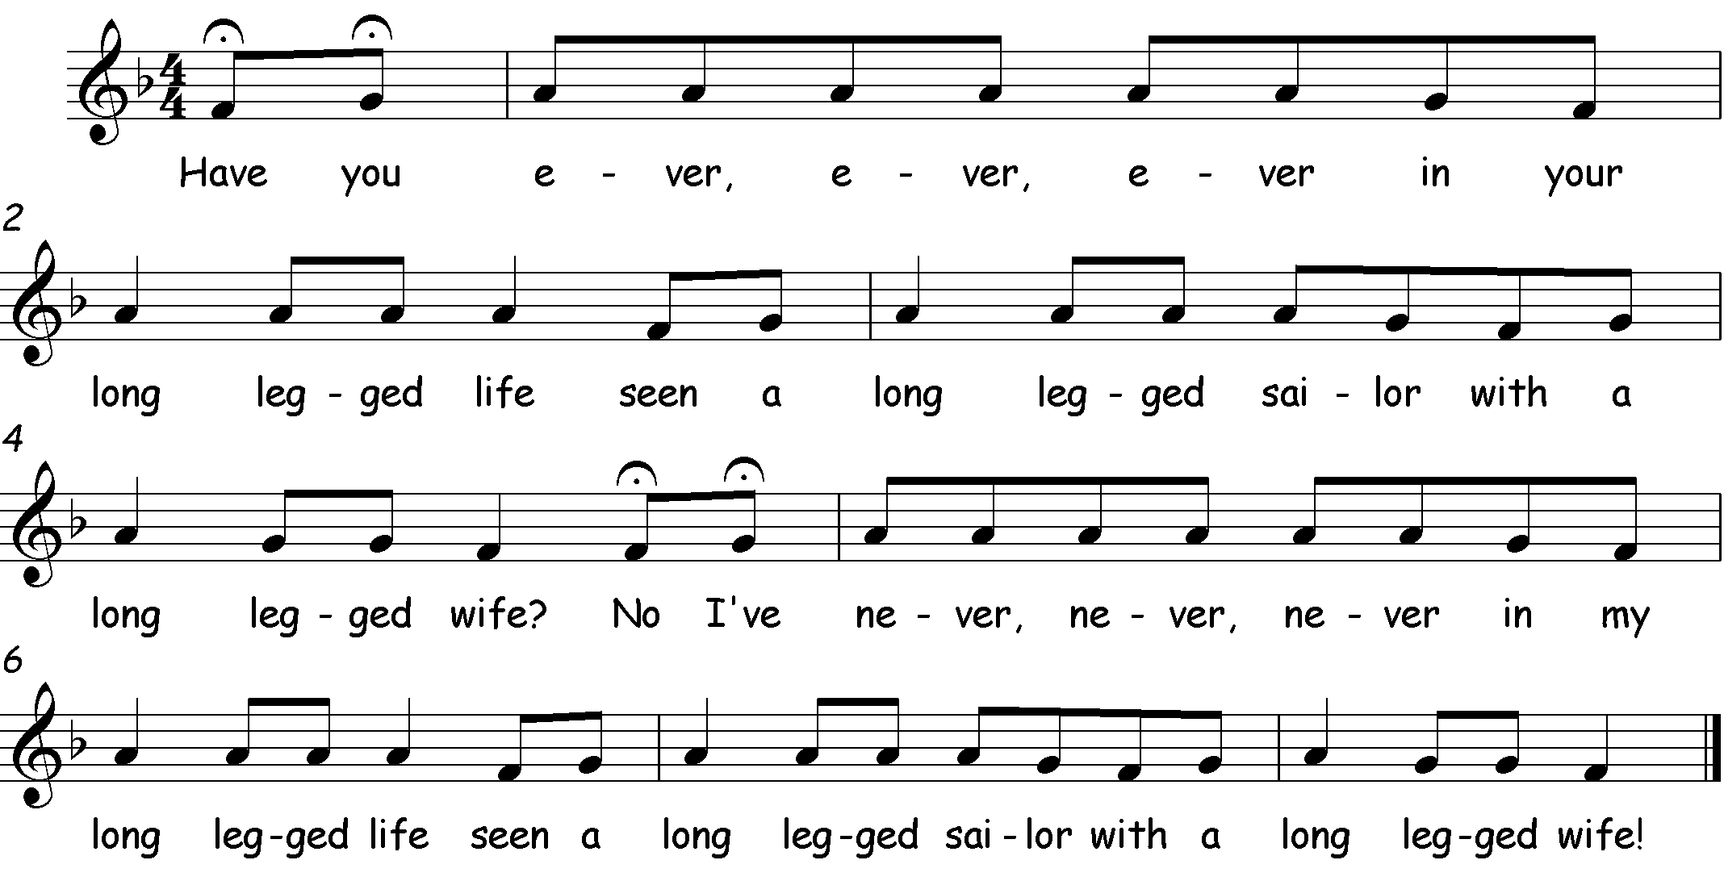
Have You Ever
Notes:
Have you……....’drum roll on knees’ Seen a………….. tap knees No I’ve……....’drum roll on knees’
Ever………....…... clap Long…………….. arms raised Never………… clap
Ever……………… tap knees Legged…………. tap knees etc…
Ever……………… clap Sailor……………. clap
In your…………. tap knees With a…………... tap knees
Long…………….. arms raised Long……………… arms raised
Legged………… tap knees Legged……......... tap knees
Life………………. clap Wife?.................... Clap
Things to try:
‘Thinking voice’ on the adjective
‘Thinking voice’ for everything EXCEPT the adjective
Other adjectives e.g. short leg-ged, one leg-ged, no leg-ged, with different actions

Slide 23
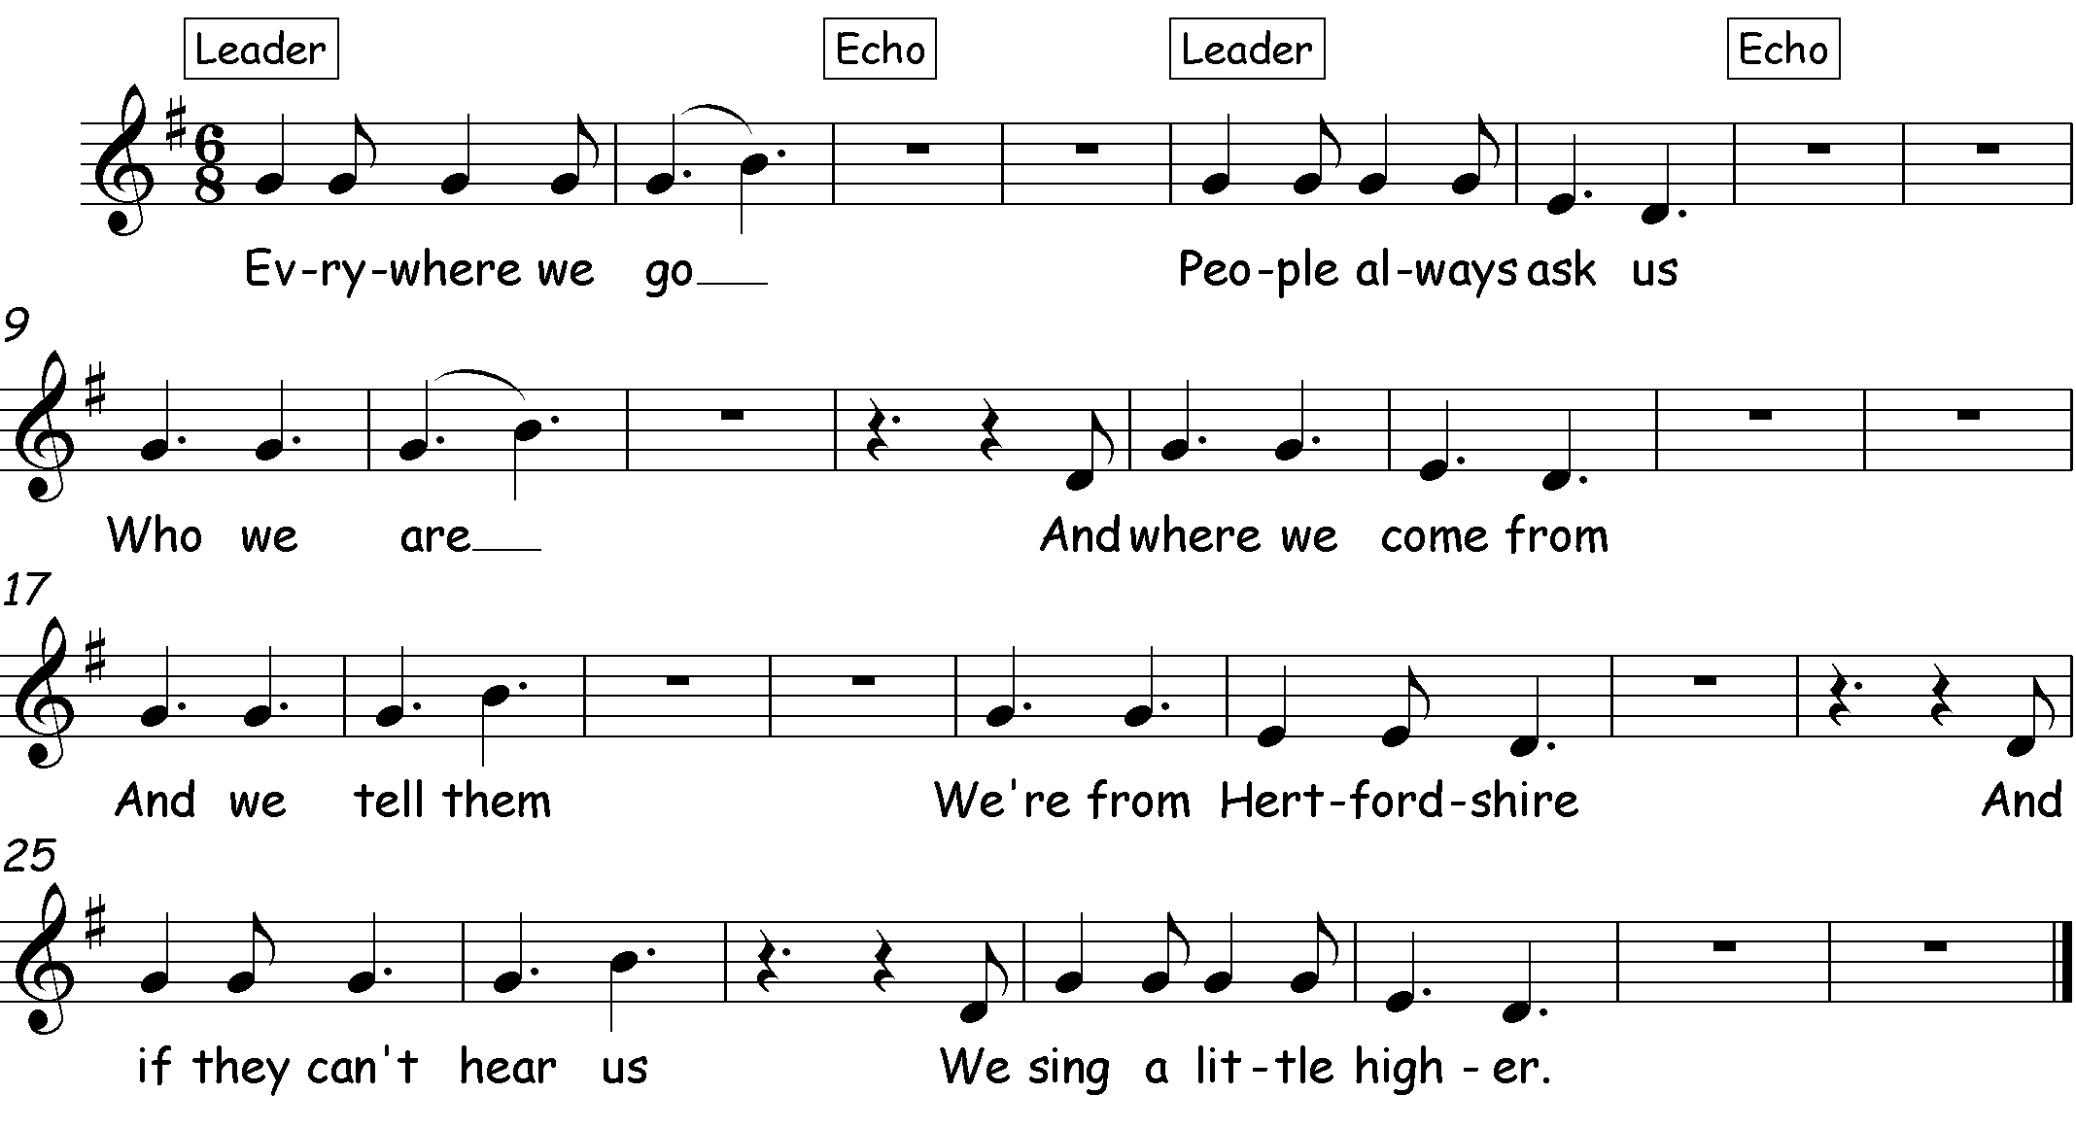
Everywhere We Go
Notes:
For this song, the Leader, teacher, adult or child chooses how the song is sung – higher, lower, quieter, faster, slower etc.
Things to try:
Insert name of school/town/area/country etc.
March like cadets – in pairs, in a long line behind each other – around the room as they sing, or on the spot – use those ‘musical eyes’ and ‘musical ears’ to follow the cue from the leader (police STOP hand signal for marching on the spot, or, pointing with finger in time to the beat, in direction you want them to march.

Slide 24
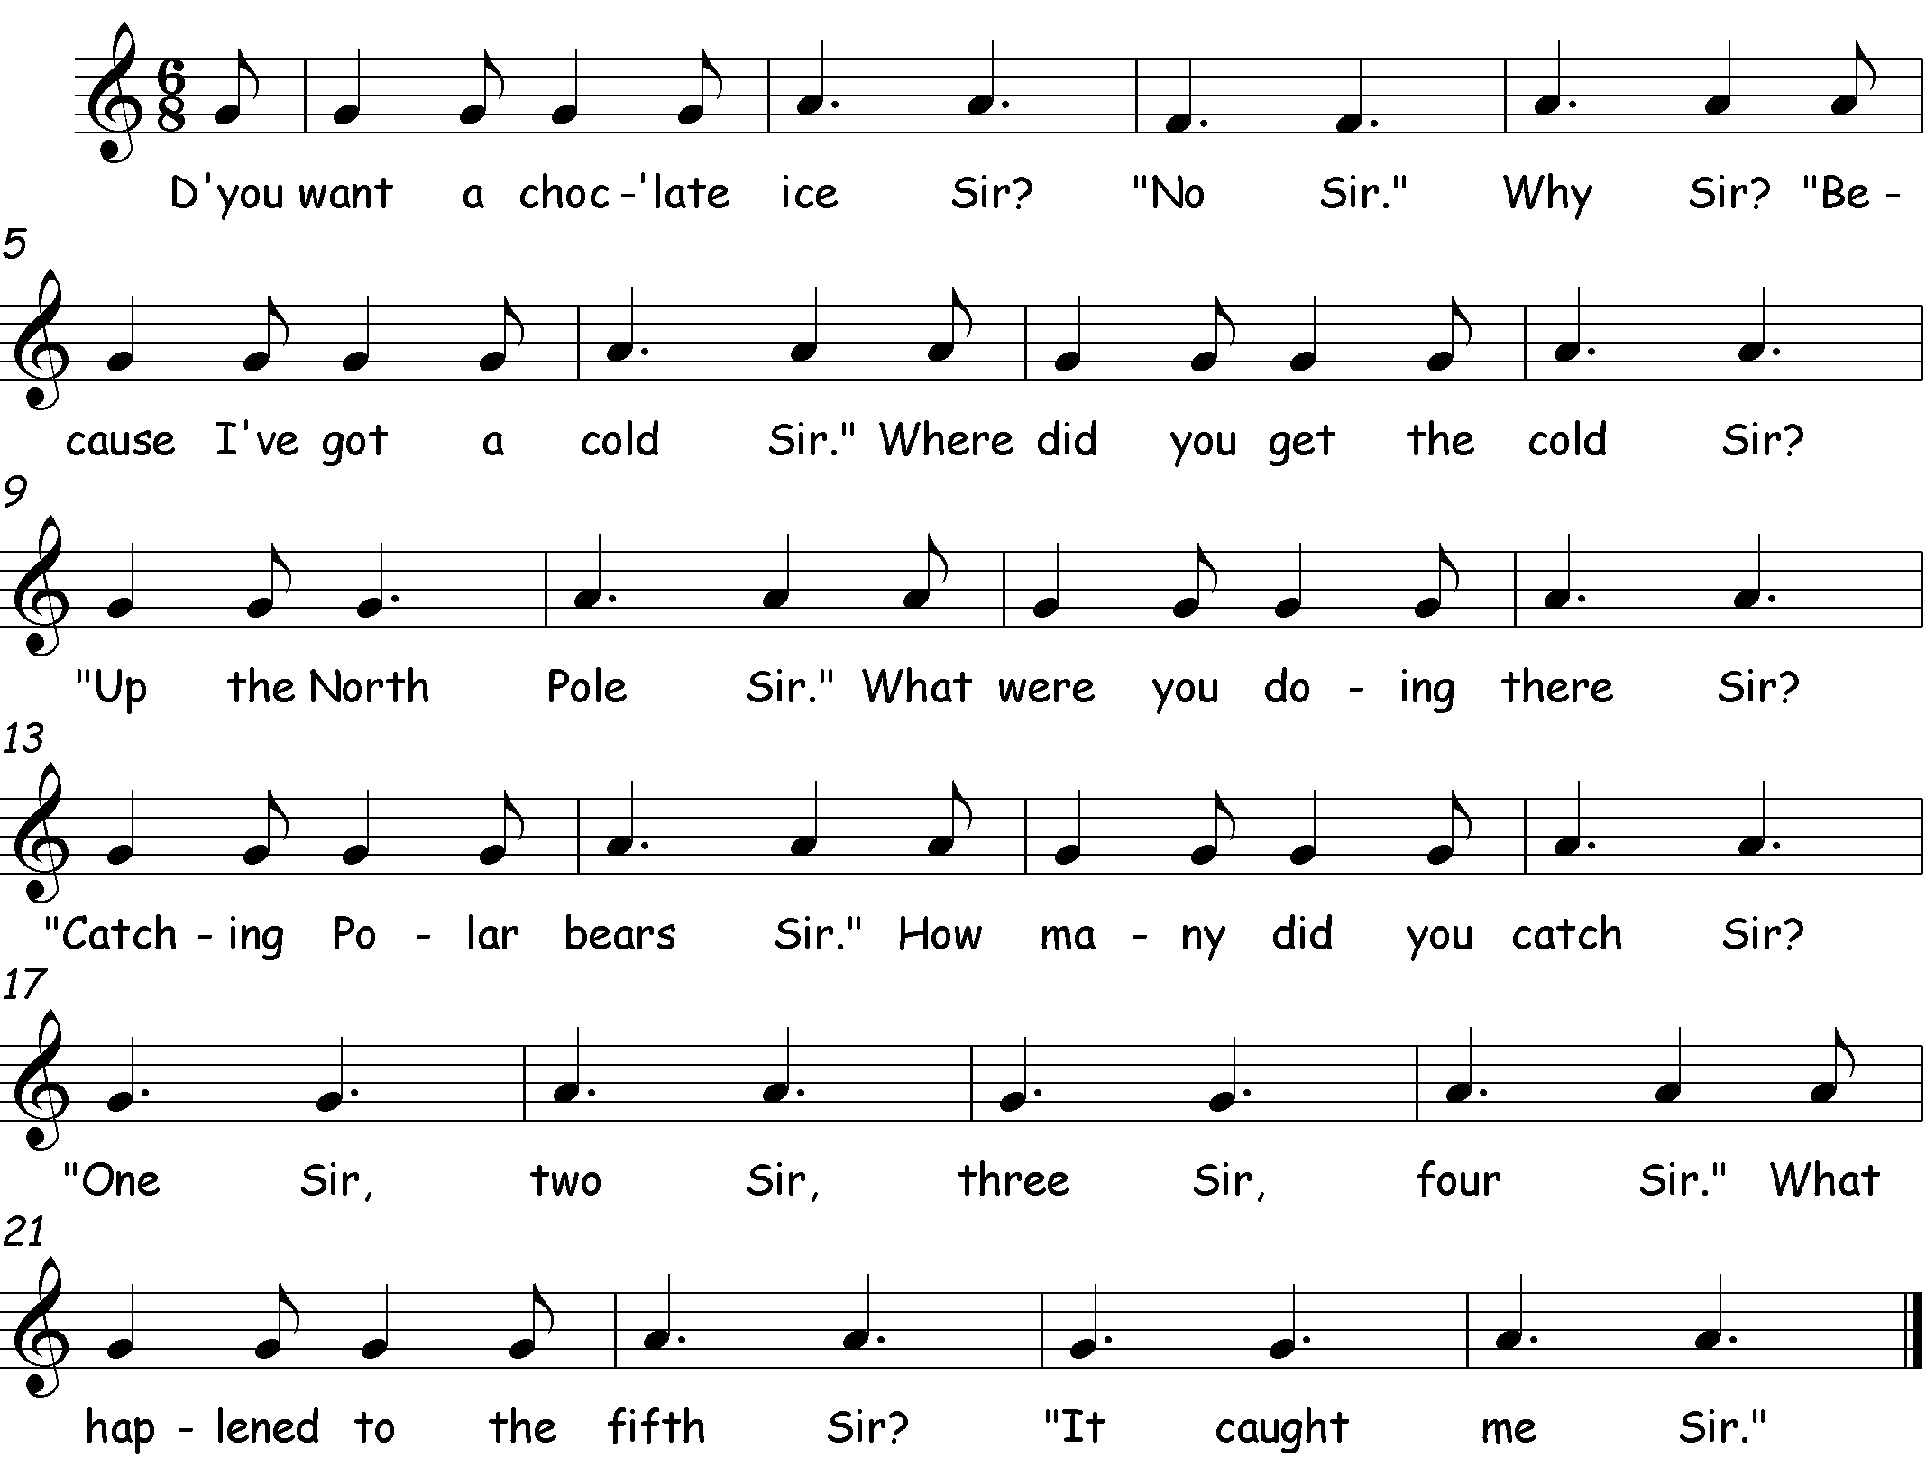
Do You Want a Choc’late Ice Sir?
Notes:
This is a song for reinforcing the ‘Call and Response’ style. Some children may be happy to sing individually, or the class could be divided in half with a leader for each half.
Things to try:
Work out some actions/drama to accompany the song using different expressions to vary the timbre (tone colour).
Add a second part following the pitches of the melody, singing the word ‘ice-cream’

Slide 25
High, Low, Chickalow
Notes:
This is a playground song for relating pitch to movement – perfect VAK learning!
Teach the song without the actions first.
In pairs facing a partner, hold out left hand as if to shake BUT instead place hands back to back (glue it to your partners!)
On the word ‘high’ clap right hands at eye level above outstretched left hands.
On ‘low’ clap below.
On ‘chicka’ clap own left hand.
Things to try:
Use ‘thinking voice’ for the words “high”, “low” or “chicka” whilst maintaining actions
Use ‘thinking voice’ for everything EXCEPT “high”, “low” or “chicka” whilst maintaining actions
Take it in turns to sing different words – partner 1 sings all the ‘high’, partner 2 sings all the ‘low’ and both together sing the ‘chikalows’. Switch it round.

Slide 26
Chest, chest, knee
Notes:
Following on from ‘High, Low, Chickalow’, this song has five pitch levels.
Note how the parts of the body (in relation to the floor and ceiling) correspond to the pitch outline – higher and lower.
Sing without actions first and then point to each relevant body part as they sing.
Things to try:
Add ‘thinking voice’ for “head” for the first sing through, then “head and chest” and so on until the whole song is in a thinking voice.
Choose body parts at random
Partner songs:
All Round the Brickyard
Cinderella/Bounce High/All Round the Brickyard

Slide 27
All Round the Brickyard
Notes:
This is a traditional song from the USA and describes a ‘brickyard’ (the four sides of the basketball court).
The challenge is to maintain a regular pulse and make every action fit to the music
All in a circle facing inwards:
All round the brickyard four steps round in a circle
Remember me tap head for each syllable of “re-mem-ber” and tap chest on “me”
Jump it jump
And a both arms outstretched, palms upwards
Things to try:
Think of new actions for each verse – stamp it, clap it, rock it, roll it, whatever you like!
The song leader (teacher or pupil) sings the verse once deciding on the action and then everyone repeats it
Partner songs:
Chest, Chest, Knee
Cinderella/Bounce High/Chest, Chest, Knee

Slide 28
Dipidu
Notes:
The song, from Uganda, uses two different METRES:
The first section has a triple metre (the pulse is grouped into threes)
The second section has a duple metre (the pulse is grouped in twos).
Facing a partner:
Tap own knees, then clap own hands once and then clap partners once. (1, 2, 3) When the music changes to “dip dip dip dip dipidu” clap own knees then partners and so on. (1, 2) Notice that beat ONE is the strongest beat and is always on the knees.
Things to try:
Make up your own patterns using body percussion
Stand in pairs, facing each other, in 2 concentric circles. At the end of the song, the outside circle moves one step to the left on the first beat of the song repetition. You have to be slick – no fussing - so that you and your new partner are able to continue without disrupting the beat or the actions!

Slide 29
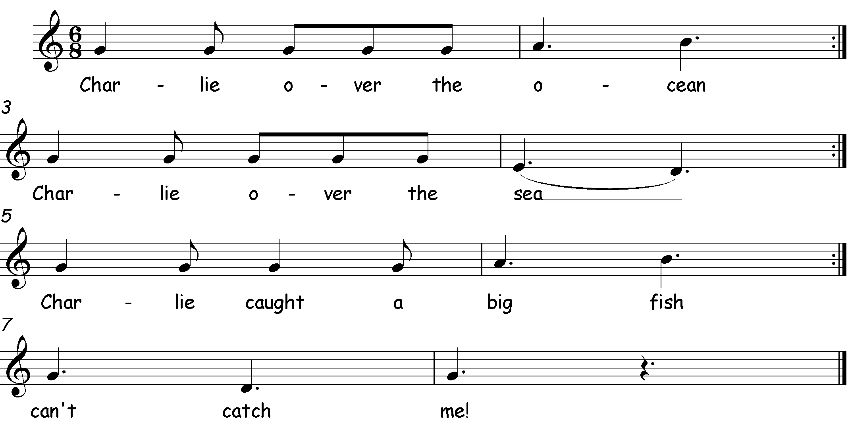
Charlie Over The Ocean
Notes:
Stand in a circle. ‘Charlie’ walks around the outside of the circle singing the first line of the song and the circle echoes back.
When the circle responds with the line “can’t catch me”, ‘Charlie’ tags the child who is standing beside ‘him’. The tagged child then chases ‘Charlie’ around the outside of the circle, trying to tag him before he reaches the vacated spot.
Whilst doing so, the circle chants “Charlie, Charlie, you cant catch me”
Whoever loses goes into the ‘fishbowl’ in the middle. The game is repeated with a new leader chosen by the teacher and the child in the fishbowl gets replaced each time.
Things to try:
The leader can replace ‘Charlie’ with their own name and think of something that ‘Charlie’ could have caught.
Divide the class into two halves, one singing the whole song and the other adding “can’t catch me” as a simple melodic ostinato (repeating pattern).
This could then be transferred to chime bars:
Can’t catch me Can’t catch me
D; A; D D; A; D

Slide 30
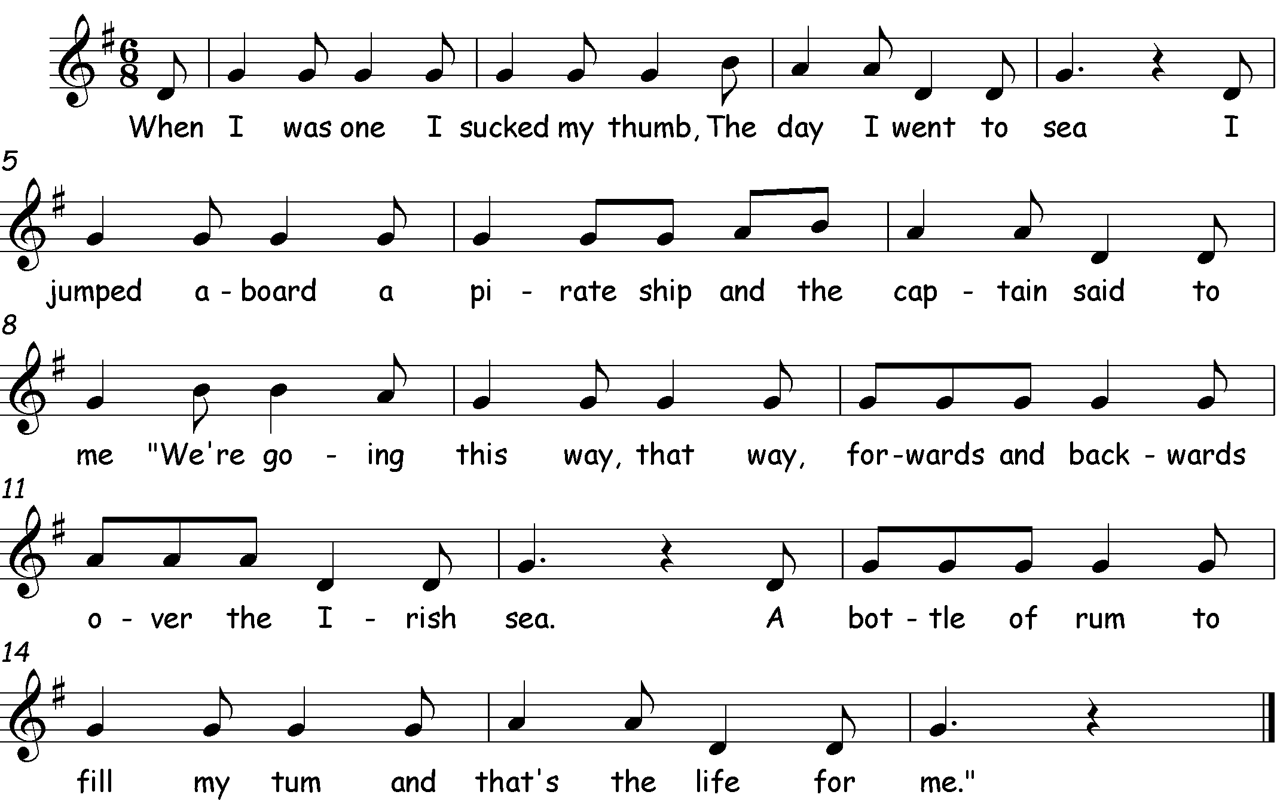
When I Was One
Notes:
When I was two I buckled my shoe…
When I was three I cut my knee…
When I was four I knocked at the door…
When I was five I learned to drive…
This traditional action song allows children to explore rhyming words as well as co-ordinating music and movement.
When I was one I sucked my thumb actions as appropriate
The day I went to sea arms make waves in front of body
I jumped aboard a pirate ship jump on the word “jumped”
And the captain said to me salute on the word “captain”
We’re going this way lean to the right with arms folded in hornpipe fashion
That way lean to the left
Forwards and backwards as lyrics
Over the Irish sea arms make waves movements
A bottle of rum ‘drink’ from a bottle
To fill my tum rub tummy
And that’s the life for me slap thighs or make ‘Ahoy’ gesture on the word “that’s”
Things to try:
- Make up new verses with interesting rhymes!

Slide 31
Obsiwana
Notes:
Versions of this native Canadian song, which translates as ‘Peace be with you’, can be found all over the World.
Sitting in a circle, each child places a stick (or clave) on the floor in front of them.
Sing the song and at * each child takes the stick from the child to the right and on the arrow puts it in front of themselves.
Things to try:
Use hockey sticks or quoits out in the playground
This fits together with ‘Funmje Alafia’ (“May your day be filled with health and happiness”) from Resource Pack One as a partner song.

Slide 32
Naka Naka Hoi!
Notes:
This Japanese song simply translates as:
Naka = inside Soto = outside Hoi = Hoi!
It works best if sung gently and quite slowly.
It has five pitches and four phrases.
Note that there are rests at the end of phrases one, two and four.
‘Naka’ two gentle taps of the fingers on ‘Na’
‘Hoi’ hands starting in praying position then moving up and away from each other in two arcs like a fountain
‘Soto’ two taps behind the back on ‘So’
Things to try:
Walk to the rhythm.
Add arm actions for amazing brain gym!!
Difficult version – walk feet to the rhythm moving on one direction, changing direction when each new phrase starts, add hand actions AND sing!!!

Slide 33
Sorida
Notes:
This is a partner song from Zimbabwe.
Stand facing a partner:
So-ri-da draw a large circle in front of the body with both hands, ending with a clap on the third syllable “da”
ri-da ri – palms of hands against partner’s hands. da –clap
Da- tap back of right hand against partner’s right hand
da- tap back of left hand against partner’s left hand
da- clap
Start very slowly and repeat slightly faster each time.
Be prepared for some confusion – getting it wrong is half the fun!
Things to try:
Change partners, holding onto the first note “SO” until everyone has a new partner.
Track 23 – sing to numbers
So-ri-da . . . 5 – 3 – 1
- Pick out the melody on a xylophone

Slide 34
El Can Can
Translation:
‘The can-can, the can-can,
All the children know how to dance
With one foot with one foot
All the children know how to dance’
Notes:
El can-can, el can-can
Todos los ninos saben bailar
Con un pie, on un pie
Todos los ninos saben bailar
Con un mano (with one hand)
Con dos pies (with two feet)
Con dos manos (with two hands)
Things to try:
‘With one foot’ tap the pulse throughout
‘With one hand’ – opposite hand waving from side to side
Add two feet tapping pulse
Add second hand in a ‘sawing action’ backwards and forwards!

Slide 35
Petit Jacques Danse
Notes:
Children who have covered the Key Stage 1 singing material in ‘Off We Go’ will recognise the melody of this song.
This is the original French version of the song which translates as “Little James dances, on my thumb he dances”
Verse two cumulatively adds the lyric ‘pied’ – foot
For example: …..pouce, pouce, pouce, pied, pied, pied etc.
Things to try:
Add the names of other body parts as appropriate.
How many parts of the body can be named and remembered?

Slide 36
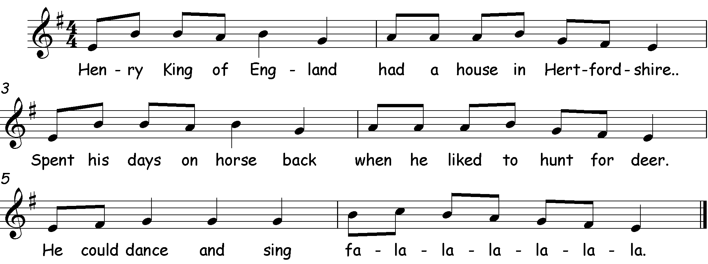
Henry King of England
Notes:
This song uses the same melody as “Petit Jacques” to outline the story of Henry VIII and Hatfield House. It is a CUMULATIVE song.
Things to try:
Add actions:
Henry King of England – place an imaginary crown on your head
Had a house in Hertfordshire – draw an imaginary square with your hands (out, down, across the bottom) and clap on the ‘Hert’ of Hertfordshire
Spent his days on horseback – ride your horse in time to the beat
When he like to hunt for deer – draw back your bow and arrow, let the arrow shoot on the word ‘deer’
He could dance and sing – throw your best disco moves to the beat
Fa la – doff your feathered hat and gradually swish it from your head to the ground.
What action could you add for the following verses of ‘like his clothes and bling’, ‘told the Church I’m King’ and ‘totalled six weddings’,?
- Track 27 – Add “fa la la la la la la” as an ‘ostinato’ (repeating pattern)
- Track 28 – Add a rhythm on a tambour (or another percussion instrument) - (ta…te-te ta… ta…, word rhythm could be drum tam-bour), to provide an authentic performance.

Slide 37
Henry King of England cont.
2. Henry King of England
Had a house in Hertfordshire.
Spent his days on horseback
When he liked to hunt for deer.
Liked his clothes and ‘bling’
He could dance and sing
Fa la la la la la la
3. Henry King of England
Had a house in Hertfordshire.
Spent his days on horseback
When he liked to hunt for deer.
Told the church “I’m King!”
Liked his clothes and ‘bling’
He could dance and sing
Fa la la la la la la
4. Henry King of England
Had a house in Hertfordshire.
Spent his days on horseback
When he liked to hunt for deer.
Totalled six weddings!
Told the church “I’m King!”
Liked his clothes and ‘bling’
He could dance and sing
Fa la la la la la la

Slide 38
There’s a Hole in my Bucket
Notes:
This traditional song tells a cyclical story.
Listen to it and use it as a model for your own songs.
Such as…
My car is too dirty . . . . . . . . . . . . . . . . . . Then wash it
So how will I wash it? . . . . . . . . . . . . . . . At a car wash
And where is the car wash? . . . . . . . . . . In (Watford, Hemel etc)
How will I get there? . . . . . . . . . . . . . . . . In the car
My car is too dirty . . . . . . (etc)

Slide 39
Christmas Bells
Notes:
Things to try:
Track 31 – Add an ostinato ‘bells are ringing’
Track 32 – This fits together as a partner song with the simpler Christmas Bells song from ‘Off We Go’ (the Key Stage 1 resources pack).
Track 33 – All of the above
Chime bars or hand chimes can be used for the ostinato
“Bells are ring-ing”
A F G C

Slide 40
Copyright Notice
We have made every effort to trace the copyright owners of the songs within these songbooks (with the majority of the songs being in the public domain already). If we have not acknowledged any copyrighted material, please contact us immediately.
Thank you to Rachel Thomas (Dawson) and Joan Wright, for the original Songbook 1&2 concept and content.
Many thanks to Joan Wright (formally a member of the Hertfordshire Primary Music Team) for generously letting us use her songs and adaptations of songs and lyrics – ‘Dads, Lads, Girls, Mums’; ‘Henry King of England’; and ‘Dean Bon Bean’.
Additional thanks to all of the past and current members of the Hertfordshire Music Service Primary Music Team.
We have also included a bibliography to credit the authors/publishers of the books where we sourced many of these traditional songs.

Slide 41
Eenie Meenie
Dean Bon Bean – adapted by Joan Wright and used with permission.
Cinderella
Dads Lads, Girls Mums - adapted by Joan Wright and used with permission.
Bounce High, Bounce Low
Maddocks, Andrew. Voices Foundation Inside Music - KS2 Aged 7-11. Published by The Voices Foundation and Alfred Publishing Co. (UK) Ltd. The Voices Foundation 2014 ©Boosey&Hawkes
Geoghegan, Lucinda. Singing Games and Rhymes for Middle Years. Published by the National Youth Choir of Scotland, 2005.
Geoghegan, Lucinda and Bell, Christopher. Go for Bronze Level One Student Book and Teacher Book,. Published by the National Youth Choir of Scotland, reprinted in 2013.
Vinden, David. An Introduction to the Educational Concept of Zoltán Kodály. Published by The Kodály Centre of London, 2006.
Rowsell, Cyrilla and Vinden, David. Jolly Music Level Three. Published by Jolly Learning LTD, 2012 and 2019

Slide 42
6. Have You Ever?
Maddocks, Andrew. Voices Foundation Inside Music - KS2 Aged 7-11. Published by The Voices Foundation and Alfred Publishing Co. (UK) Ltd. The Voices Foundation 2014 ©Boosey&Hawkes
Geoghegan, Lucinda and Bell, Christopher. Go for Bronze Level One Student Book and Teacher Book,. Published by the National Youth Choir of Scotland, reprinted in 2013.
7. Everywhere We Go
8. D’you Want A Choc’late Ice Sir?
9. High, Low, Chickalow
Maddocks, Andrew. Voices Foundation Inside Music - KS2 Aged 7-11. Published by The Voices Foundation and Alfred Publishing Co. (UK) Ltd. The Voices Foundation 2014 ©Boosey&Hawkes
Geoghegan, Lucinda. Singing Games and Rhymes for Middle Years. Published by the National Youth Choir of Scotland, 2005.
Geoghegan, Lucinda and Bell, Christopher. Go for Bronze Level One Student Book and Teacher Book,. Published by the National Youth Choir of Scotland, reprinted in 2013.
10. Chest, Chest, Knee, Toe
Maddocks, Andrew. Voices Foundation Inside Music – Ages 5-7. Published by The Voices Foundation and Alfred Publishing Co. (UK) Ltd. The Voices Foundation 2014 ©Boosey&Hawkes

Slide 43
11. All ‘Round the brickyard – Kodaly Centre, The American Folk Song Collection website (David McIntosh ‘Singing Games and Dances’)
Dipidu
Geoghegan, Lucinda. Singing Games and Rhymes for Middle Years. Published by the National Youth Choir of Scotland, 2005.
Geoghegan, Lucinda and Bell, Christopher. Go for Bronze Level One Student Book and Teacher Book,. Published by the National Youth Choir of Scotland, reprinted in 2013.
13. Charlie Over The Ocean
Neilson, Katie. Voices Foundation Inside Music – Early Years Ages 0-5. Published by The Voices Foundation and Alfred Publishing Co. (UK) Ltd. The Voices Foundation 2016 ©Boosey&Hawkes
Geoghegan, Lucinda. Singing Games and Rhymes for Early Years. Published by the National Youth Choir of Scotland, 1999.
Erdei, Peter (editor). 150 American Folk Songs to Sing, Read and Play. Published by Boosey and Hawkes, 1974.
When I Was One

Slide 44
Obsiwana
Maddocks, Andrew. Voices Foundation Inside Music - KS2 Aged 7-11. Published by The Voices Foundation and Alfred Publishing Co. (UK) Ltd. The Voices Foundation 2014 ©Boosey&Hawkes
Skidmore, Jeffrey. Singing Playgrounds. Published by Ex Cathedra.
Geoghegan, Lucinda. Singing Games and Rhymes for Middle Years. Published by the National Youth Choir of Scotland, 2005.
Geoghegan, Lucinda and Bell, Christopher. Go for Bronze Level One Student Book and Teacher Book,. Published by the National Youth Choir of Scotland, reprinted in 2013.
16. Naka Naka Hoi
Geoghegan, Lucinda. Singing Games and Rhymes for Middle Years. Published by the National Youth Choir of Scotland, 2005.
17. Sorida
Maddocks, Andrew. Voices Foundation Inside Music - KS2 Aged 7-11. Published by The Voices Foundation and Alfred Publishing Co. (UK) Ltd. The Voices Foundation 2014 ©Boosey&Hawkes
Geoghegan, Lucinda. Singing Games and Rhymes for Middle Years. Published by the National Youth Choir of Scotland, 2005.

Slide 45
El Can Can
Petit Jacques Danse
20. Henry King of England - lyrics written by Joan Wright and used with permission.
There’s a Hole in my Bucket – Traditional, Sing Up?
Christmas Bells.

