Slide 1
Sing, Sing, Sing! Book 1: “Off We Go”

Slide 2
Sing Sing Sing!
A progressive Singing Scheme from Hertfordshire Music Service’s Primary Music Team.
Singing is great, and we do it for lots of reasons; there are songs from different times and places, songs in different languages which offer us a flavour of a range of cultures, and a whole host of styles and genres. We use it to make music together, to learn about something, to come together, to express our emotions and to celebrate.
We know that singing has many benefits. But what about Progression in Singing, the actual learning how to sing?
We progress through:
Quality (doing something better and with more attention to detail)
Demand (being able to tackle harder things)
Range (widening our knowledge and repertoire)
Progression through Quality and Demand depend on us using material at the correct level for children to be able to have the most success.

Slide 3
All songs help us to expand our range, but which songs actually help us to learn to sing and to improve it, to pitch-match, to use vowels to make and carry sound and consonants to carry meaning? To use rhythm and phrase to convey the emotion and message of a song? To use dynamics to really light up a performance?
Looking at song books it can be difficult to work out which songs to chose to allow children’s voices to develop systematically and naturally, with attention to detail and satisfaction of a good job done.
This is where Sing Sing Sing! comes in. Think of it as a Reading Scheme for singing where all the work on selecting material for progression has been done for you.
This doesn’t mean that you can’t sing any other songs - far from it! Having a singing ‘scheme’ will allow you to use other songs for all the purposes you need. Just as using a Reading Scheme it doesn’t mean we deny children access to other books - think of those other songs as Library Books to enhance our pleasure and enjoyment of singing!

Slide 4
Sing, Sing, Sing! comes in 3 ‘e-books’:
Off We Go for Years 1 and 2
Moving On Up for Years 3 and 4
Aim Even Higher for Years 5 and 6
Each ‘book’ has around 20 songs which can be spread across the two school years they are designed for. They are mostly short, allowing you to concentrate on quality rather than quantity. There are no lengthy words to learn; everything has been chosen for a musical purpose and there is room for repetition and consolidation to build the children’s confidence and familiarity.

Slide 5
They are designed to be used in classrooms, projected onto boards, with the musical notation visible as well as the words. We know that children can become familiar with musical notation by being exposed to it little and often, and that they begin to identify melodic shape and rhythmic features this way. Features of notation can be pointed out as you learn.
All you need is there, and there are teacher notes to support the learning. We have chosen these songs because we know children love them, as well as developing their singing skills, and we hope that you will enjoy singing them with your class.
The HMS Primary Music Team

Slide 6
Setting the Expectation
Young children need help to ‘find’ their singing voice. When they have done so and can show accurate pitch matching, shower them with praise as this is an important developmental milestone.
Quiet singing and ‘smiling eyes’ help to achieve accuracy of pitch.
Be rigorous in helping them to achieve a beautiful, unforced “Angel” voice. Do not accept anything less.
At all times aim to be a good role model and encourage other supervisory adults to do the same.
Establish a good singing body:
Standing feet slightly apart, relaxed shoulders, arms loosely by sides.
If chairs are available, establish a good “singing seat” sitting away from the back of the chair, feet tucked slightly underneath, feet together and hands flat on lap.
Wherever possible, avoid sitting on the floor.

Slide 7
Pitch Progression
Once children can hear and feel the difference between their speaking and singing voice, it is possible to introduce two pitches, “so” and “mi”.
This minor third interval sounds like a “cuckoo”. It is the most instinctive interval for children to sing in any culture. This “so-mi” TONESET must be established before you attempt anything more complex.
The songs in this presentation start from this tone set and progress to the PENTATONE of l-s-m-r-d.
i.e. s-m -> l-s-m -> m-r-d -> l-s-m-r-d
In selecting any songs you use, always bear this progression in mind. Some songs may also have more challenging lyrical content or tempo and therefore may be more appropriate for older children.
Young children’s voices are at their best if kept within their natural range or Middle C to the B above.
Please refer to our Singing Skill Progression Document for further information and detail.

Slide 8
Skills Progression
Distinguishing speaking and singing voices
Finding the pulse
Pitch matching
Individual singing
Awareness of phrase
Rhythm and duration (including rests)
Rhythm and pulse
Using the thinking voice
Comparatives [faster/slower/louder/quieter/higher/lower]
Please refer to our Singing Skill Progression Document for further information and detail.

Slide 9
How to Teach a Song
Sing the song through TWICE to encourage really good listening from the children. Insist upon “listening bodies” (or whatever is age appropriate).
Establish a “my turn, your turn” system using a “Police Traffic Control” hand/hand cupping ear to indicate that they first listen to a section. Then use an open-hand gesture which is the sign for them to copy straight away.
If your song has four phrases, sing one, then children copy and then sing phrase two, then children copy etc.
Next sing through phrases one and two before the children copy phrases one and two.
Repeat the process for phrases three and four.
THEN sing the whole song twice, if need be, giving them the sung starting pitch and tempo using “Off we go”.
THEN the children should sing the song through without you and any other adults joining in.
GOLDEN RULE-DDW “Don’t do it with them”
Singing along with the children all the time can lead to an over reliance on the teacher. It is important for us to listen to the children to assess their progress and achievement.

Slide 10
Other Activities
Get the children to choose a song they know well and:
find the pulse
tap the rhythm pattern
sing some sections aloud, some in ‘thinking voice’
sing the songs higher or lower (pitch)
sing the songs faster or slower (tempo)
sing the songs louder or quieter (dynamics)
show the phrases with ‘Rainbow Arms’
rehearse the songs in pairs or small groups to share with the class

Slide 11
Types of Song (with examples)
Warm ups (Chop Chop)
Good “openers” (Touch Your Shoulders)
Songs in another language or from another culture (Funmje Alafia)
Songs with an opportunity for quality singing and vocal development with which to set high expectations (Suo Gan)
Songs with movement (Step Back Baby)
Songs with the potential for part-singing (Oo A Lay Lay)
Good “finale” songs (Bow, Wow, Wow)

Slide 12
How to download the audio files…
In order to keep the power point files small we have not embedded the audio files; they can be located by following the following link:
hertsmusicservice.org.uk/songpackone
To download the track(s) click on the download icon (hover the mouse over the track name to see it) and save in your chosen location. You will need to create a Soundcloud account to download files.
To embed into the slideshow simply drag and drop from your chosen folder onto the relevant slide and resize/reposition as required.
Alternatively you can play them directly from your chosen folder or stream them each time you use them if you prefer.

Slide 13
The Songs
Have You Brought Your … Voice?
Choppety Chop
Hello, How Are You?
Touch Your Shoulders
Here I Come (Lemonade Song)
Starlight, Starbright
Ding Dong
Row, Boys, Row
On A Log
Suo Gan
Pease Pudding Hot
Finding singing voice
Pulse, diction (spoken)
Pitch matching
Pitch matching, pulse, thinking voice
Pitch matching, children leading
Legato singing, phrases, breath control
Diction, rhythm
Rests, pulse, phrasing
Rhythm
Legato singing, repeated rhythmic patterns
Rests, thinking voice, into 2-parts

Slide 14
The Songs cont.
What Shall We Play?
Engine, Engine
Bow, Wow, Wow
Little Johnny Dances
Funmje Alafia
Step Back Baby
Un Eléphant
Oo A Lay Lay
Kaeru No Uta Ga
Hear The Christmas Bells
Pulse, names of instruments
Pulse, phrase, rhythm, pitch control
VAK, pitch control, thinking voice
Minor key, repeating patterns, pulse
Rhythm, into 2 parts
Diction, pulse, into 2 parts
Pitch, pulse
Call and response
Pitch outline, into 2 parts
Into 2 parts

Slide 15
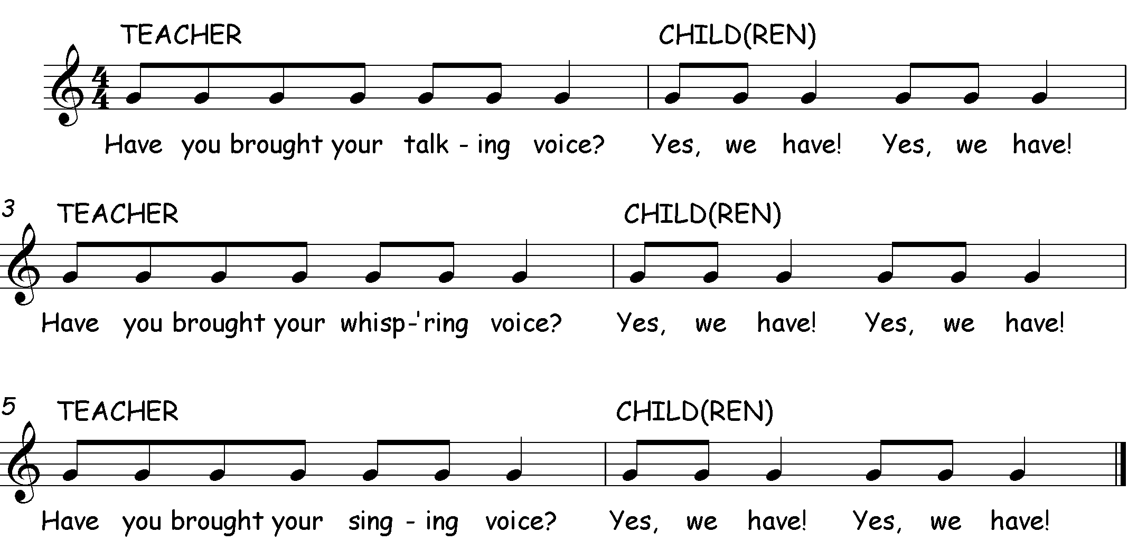
Have You Brought Your … Voice
Notes:
This chant helps children to identify the difference between the spoken voice and the singing voice. It is a great way of warming up and exploring the range and quality of sound that can be produced.
Things to try:
Explore different voices (posh, teacher, angry, sad, witch, big, bear, mouse, Elvis etc)

Slide 16
Choppety Chop
Notes:
This is a great song for finding the pulse.
Children can use a chopping action to ‘chop’ different sized ingredients (a stir-fry for Chinese New Year, healthy fruit salad, a warming soup). One hand held out flat as a chopping board, whilst the other hand, on its side, chops down onto the board. Notice what happens to the volume when they chop large/small items… try different tempi too (how would a professional chef chop something up? – fast, how would children chop something up? – slow!)
If the children find the words hard to articulate, even at quite a slow tempo, it is fine if they simply imitate your pulse and listen to your voice.

Slide 17
Hello, How Are You?
Notes:
A great song for pitch-matching.
When a child has matched a given pitch it is a special moment and a turning point in the beginning of their musical life so SHOWER THEM WITH PRAISE and point out their achievement to the class, commenting on their Angel voice and excellent listening (if appropriate to the child’s specific needs and character).
Some children may pitch a little lower or higher but still with the pitch outline – praise them for good effort and “what a lovely low voice you have”, for example, BUT, resolve to help them explore the full range of their voice with carefully chosen warm-ups with higher/lower “scooping” sounds, e.g. coming down a slide.
Some children take a long time to find their singing voice. Even if they have experienced this type of musical pedagogy some may not find their singing voice until around the age of seven, and may still tend to use their speaking voice instead.
When the majority of the group can “pass this song” around the circle and stay at the same pitch (it can be done) you can give them (and yourself) a HUGE pat on the back!

Slide 18
Touch Your Shoulders…
Notes:
Another great song for demonstrating and feeling the pulse. Children can touch the relevant body part twice as they sing. Once they are more familiar with the song, they can sing one or more of the body parts in their “thinking voice” (“internalising” the song in their heads). This is part of musicianship. Please beware of saying “which part shall we miss out?” as we don’t want to miss the part out; we hear it in our heads! As a stepping stone to this huge musical development, encourage children to use their “magic lips”, where they mouth the words but don’t vocalise. REMEMBER: MAGIC LIPS INTO THINKING VOICE.

Slide 19
Here I Come (Lemonade Song)
Notes:
Once children are confident they can start this song themselves and thereby have ownership of it.
There is opportunity for discussion re higher and lower; one child may start “Here I come” at a different pitch from another and children should be encouraged to match the pitch of the “leader” and to notice these differences.
Things to try:
Hold both hands out palms up as a hand gesture when singing the questioned response
The leader walks to a child, on the beat, during the second line of the song and “fills up the glass” of the child they have chosen to be the next seller
All Clap the beat throughout
All Clap the word rhythms throughout (clap what they sing)
Clap the word rhythm only when you sing– this could be a simple introduction to working in 2 parts

Slide 20
Starlight, Star Bright
Notes:
This song should be sung in a beautiful legato (smooth) style.
It is great for PSHCE! The simple, two pitch tone set will mean that the children can focus on beauty of tone rather than on negotiating a tricky melody.
Things to try:
Pass a beautiful hand made star around the circle to the beat. Whoever is holding the star at the end of the song gets to make a wish – everyone close eyes and listen whilst the wish is made!
Identify the different rhythm of each of the four phrases – say and clap. Are there any phrases the same?

Slide 21
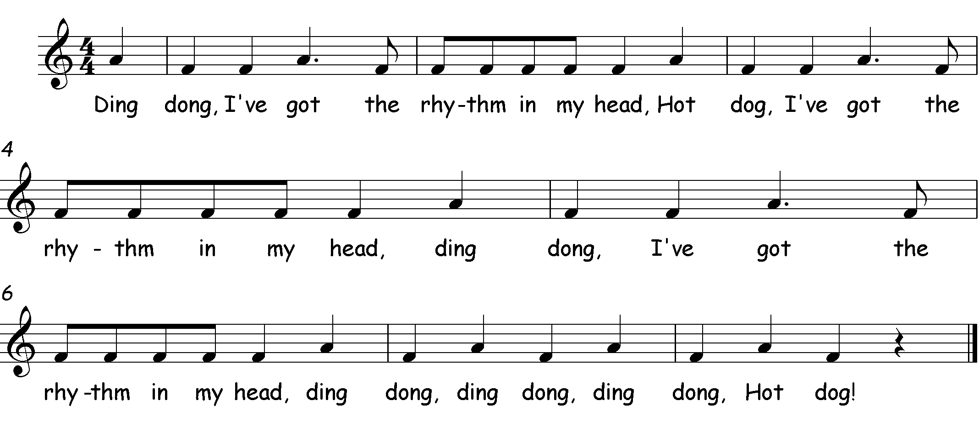
Ding Dong
Notes:
Clear words are vital in this song, which will need slow rehearsal at first. Notice how phrases one and three are identical whilst four is the odd one out.
Things to try:
“Thinking voice” on the words “Ding Dong” and “hot dog”
Movements on those words e.g. clapping for “Ding Dong”, stamping feet for “hot dog”
Can the children think of alternate actions or body percussion sounds?

Slide 22
Row Boys Row
everybody
everybody
Notes:
The pulse can be felt by doing a pull/push rowing action.
Notice the four phrases (groups of notes that form a kind of musical ‘sentence’ – useful link to literacy here!). There is a pattern for the children to notice - phrases one and four (“row, boys, row”) are the same. At the end of phrases one, two and four there are rests – beats of silence in the music (N.B. the pulse carries on through the rests).
Notice how the rhythm fits with the words and the pulse is like a continuous heartbeat.
It is important that children understand the difference between rhythm and pulse.
Things to try:
Sit in pairs, facing each other and holding hands. Row to the beat forwards and backwards (make sure bottoms stay on the floor and the rowing is controlled – we don’t want the boat to wobble and capsize!)
One half of the group rowing to the pulse, the other tapping the word rhythm. It’s a great way of exploring the concept of the beat carrying on whilst the rhythm may not (silent beat as in end of bar 2, 4, 6)
This is also a great song for encouraging very careful listening. As the leader, you can change your sung ‘ready steady off we go!’ to ‘boys are you ready, off we go!’, ‘girls are you ready, off we go!, ‘everybody ready, off we go!’ so that only those instructed to sing can sing whilst the others continue rowing.

Slide 23
On A Log
Notes:
This simple song is not only brilliant for the beginnings of pitch matching and finding the singing voice, but also for copying and inventing rhythm patterns. Add a spoken “gwa” (frog sound) rhythm pattern at the end of the song. It is also brilliant as a way of introducing the use of percussion instruments to create sound effects.
Other creatures that could sit on the log and sing could be:
Slinky Snake - hissing vocal sound at the end
Itchy Flea - scratching sound
Bumble Bee - buzzing sound
Ask the children for the own ideas – this will give them ownership of the song and encourage them to join in.
Things to try:
Introduce the use of percussion instruments to create rhythmic sound effects

Slide 24
Suo Gan
Notes:
Suo Gan = Welsh for “lullaby”
This is lovely for practising quiet singing through long, legato (smooth) phrases. Children can rock their babies to the pulse.
Things to try:
Identify the repeating rhythm pattern.
Which phrases have the same pitched melody? Phrases one and three are identical in melody as are phrases two and four, creating an ABAB structure.

Slide 25
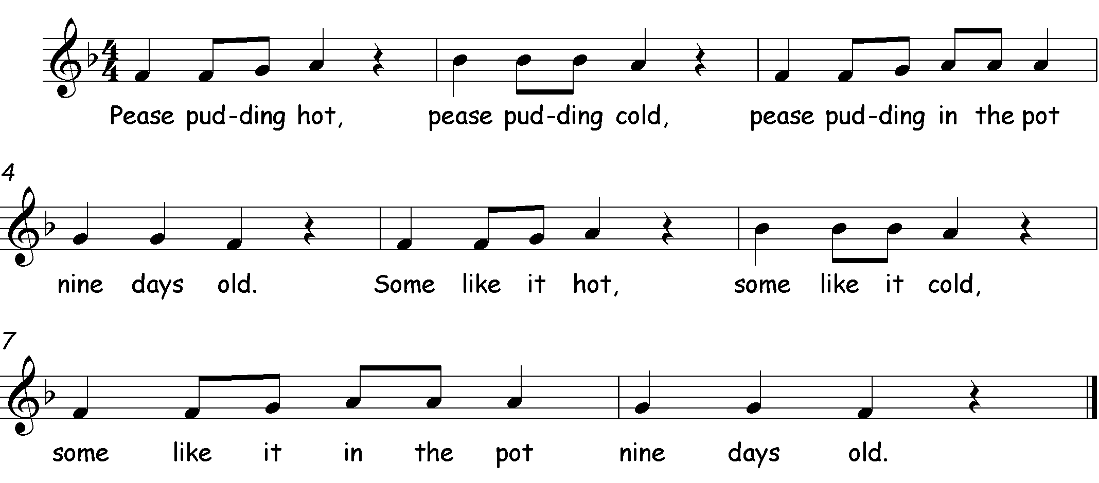
Pease Pudding Hot
Notes:
This traditional song, from the North East, is packed with musical possibilities!
Try; pulse (on knees), tapping rhythm with “rhythm hands” (two fingers tapping on opposite palm), rests emphasized with a silent action (hands apart, nod of the head, finger to lips).
It is great fun for the children to substitute sound effects for the rests; a ‘fanning the mouth’ action for “hot”, “brr” and rubbing shoulders for “cold” then a “yuk” with a grimace after “nine days old”.
Things to try:
Children sit cross legged on floor and rock side to side to show the beat whilst they sing. This will allow you to identify where the silent beats are.
The whole song in thinking voice with JUST the sound effects (quite tricky – you may need an audible pulse to begin with, then use the visual pulse, and finally try it without any help – can everyone use their ‘musical eyes’ and ‘musical ears’ to perform all the actions and sound effects together?)
The song works beautifully in canon (staggered start). Start a second group after “Pease pudding hot, pease pudding cold”. This is more challenging and would benefit from the help of an extra adult if possible. This is another great way to introduce, and develop, 2 part singing.

Slide 26
What Shall We Play?
2. We shall play on the tambourine, tambourine, tambourine.
We shall play on the tambourine, when we cant go out to play.
Notes:
This is a great song which uses mime to show the pulse. This has a lovely energising tempo.
Things to try:
Identify orchestral families
Introduce unpitched percussion instruments and play in time with the pulse.
Be a marching band! Pick up those instruments, and march around the room (you will need to be the leader until children are able to take your spot) playing the appropriate instrument at the appropriate time. This is tricky as there is lots of coordination and multiple musical skills being combined. Everyone will need to use those ‘musical eyes’ and ‘musical ears’ for this to be a success - it is great fun!

Slide 27
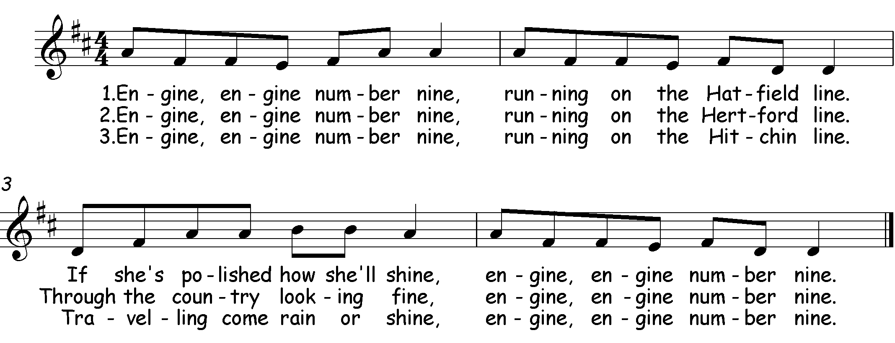
Engine, Engine, Number Nine
Notes:
Plenty of scope here for train movements to the pulse and for slower/faster trains (changes of tempo).
Notice how the rhythm pattern of each phrase is the same. Feeling the shape of each phrase, where it begins and ends can be represented with rainbow shapes/paintbrush strokes in the air.
The melody of phrases two and four are the same.
Look at the pitch outline of each phrase. Which ones end on a higher note and which ones end on a lower note? How could the children be helped to represent this movement using gestures?
Things to try:
Half of the group tapping the pulse on knees, the other half tapping rhythm THEN SWAP!
Half of the group doing ‘rainbow arms’ for phrase and the other singing the melody and showing pitch outline with gesture
Thinking voice game; (phrase by phrase) using a red card for thinking voice and a green card for singing out loud. Individual children can be in charge of the cards!

Slide 28
Bow, Wow, Wow
Notes:
This is great song for behaviour management, because it mixes the group up beautifully!
Stand in a circle opposite a partner.
Tap each other’s palms together on “bow wow wow”
Point fingers rhythmically on “whose dog art thou?”
On “Little Tommy Tucker’s dog” swap places then sing “bow wow wow” with the same tapping of palms.
IMMEDIATELY turn away from your original partner (you will actually do that during the rest at the end of the phrase)
Then you will be face to face with a new partner and the song carries on!
Things to try:
Use your ‘thinking voice’ for certain phrases to give extra challenges
Add a drum beat as an accompaniment
Add a ‘woof’ on the silent beats – what kind of dog is it? (you can explore pitch and dynamics here)

Slide 29
Little Johnny Dances
2. Little Johnny dances,
On my knee he dances
On my knee, knee, knee
On my thumb, thumb, thumb
Little Johnny dances.
3. Little Johnny dances,
On my head he dances
On my head, head, head
On my knee, knee, knee
On my thumb, thumb, thumb
Little Johnny dances.
repeat
repeat
Notes:
This is a wonderful song for matching the pulse and remembering a sequence of actions.
“Little Johnny dances” on your thumb in time to the pulse. Ask the children for a new body part for the second verse. At the last line of the song add the new body part to the previous one.
e.g. “on my head, head, head, on my thumb, thumb, thumb, little Johnny dances…”
Things to try:
- Use a puppet or an appropriate soft toy to ‘dance’ in time with the pulse

Slide 30
Funmje Alafia
Translation: “May your days be filled with happiness. Amen. Amen.”
Notes:
This is a song that is difficult to sing standing still – you just have to move!
Step side to side in time to the beat – it looks and sounds amazing if everyone can move in the same direction at the same time.
Add sleigh bells – if you have those little ones on elastic then attach them to children’s ankles so the bells play in time to the beat as they move from side to side.
To reinforce the idea of call and response, give the two groups different coloured scarves e.g. red for the funmje group, and blue for the ashe – as they sing their part they can swish/flick their scarf in time to the beat high and low, side to side – it’s up to you!
Clap the rhythm of the lyrics (use two fingers, it makes a much better quality of sound than the whole hand) as a call and response.
Divide the group into two with one part clapping the rhythm of the lyrics “Funmje Alafia” and the other part replying “Ashe Ashe” then SWAP!
Use the same idea with the melody.
Things to try:
One half of the group clapping/tapping the rhythm and the other half replying with the melody, then SWAP!
Build up a performance adding a third group stamping to the pulse.
Be as creative as you like!

Slide 31
Step Back Baby
CALL
RESPONSE
Not last night but the night before; Step back baby, step back
Twenty-four robbers at my door; Step back baby, step back
Open up the door and let them in; Step back baby, step back
Hit ‘em on the head with a rolling pin; Step back baby, step back
I picked up my frying pan; Step back baby, step back
Should’ve seen the way those robbers ran; Step back baby, step back
Some ran east and some ran west; Step back baby, step back
Some flew over the cuckoo’s nest; Step back baby, step back.
Notes:
This is a very good song for energising children’s singing. The dance steps for the chorus are simple and help to emphasise the pulse; back with the right foot, back with the left foot, then forward with right foot, forward with left.
The children may like to invent similar moves to emphasise the pulse for the verses. For example for “Hit ‘em on the head…” they could mime hitting their OWN heads
Things to try:
Children acting as soloists, taking a verse each to create a call and response effect – even more challenging.
Clap the word rhythm of the response
Can they clap the word rhythm of the response whilst performing the dance step sequence – this is tricky!

Slide 32
Un Éléphant
2. Deux éléphants, ça trompe, ça trompe,
Deux éléphants, ça trompe énormément!
3. Trois éléphants, ça trompe, ça trompe,
Trois éléphants, ça trompe énormément!
4. Quatr’ éléphants, ça trompe, ça trompe,
Quatr’ éléphants, ça trompe énormément!
5. Cinq éléphants, ça trompe, ça trompe,
Cinq éléphants, ça trompe énormément!
Notes:
This is a marvellous song with which to explore dynamics not to mention counting and singing in French!
A great way to start is to get all the children to stand to attention in their ‘elephant brigade’ with their ‘trunks’ (arms) in the air “Eléphant Attention!”
If you’re feeling brave, you could really get into it and sing the introduction in French too ‘un deux trois partons!’ (not quite the same as our ready steady off we go, but easy to remember!)
Match the pulse by swinging arms backwards and forwards (elephant trunk)
Choose “un éléphant” to be the brigade leader to make an enormous trumpeting sound at the end of each verse. Add two, three, four and five elephants and notice what happens to the trumpeting sound as each additional elephant joins in.
Things to try:
March around to the pulse in an “elephant ring”
Use a group of confident solo singers – what happens to the dynamics (volume) each time another elephant joins in?

Slide 33
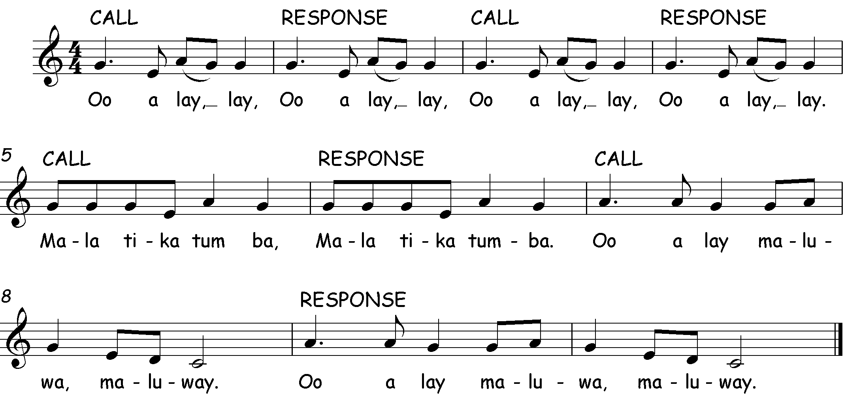
Oo A Lay Lay
Notes:
This is excellent for introducing call and response songs and, by definition, the idea that there are two parts (soloist/chorus, or two halves of the same group).
This song is a little more challenging, so may be appropriate at the end of KS1 or into KS2 - depending on the singing experience of your class.
The “oo” sounds are good for warming up the voice and the consonants in “mala tika tumba” need to be very clear and percussive,
Things to try:
Canoeing actions to reinforce the pulse. Divide the class into canoes/rafts and sit one behind the other in lines. Have an imaginary paddle and pull it through the water in time to the beat – don’t forget alternate hands for the paddles otherwise you’ll go in circles!!
You could have a drummer at the font of the canoe, like in a dragon boat race, to keep everyone rowing in time. You could then explore different tempi. Your drummer could also be the caller if you want a solo part.
If you have more than 1 canoe/raft, divide the singing so that some sing the call and other the response so you are ‘throwing’ the 2 parts across the boats.
An extension activity could involve holding on the final note of each phrase whilst the other group are singing their part, to create an overlapping texture with a drone effect.

Slide 34
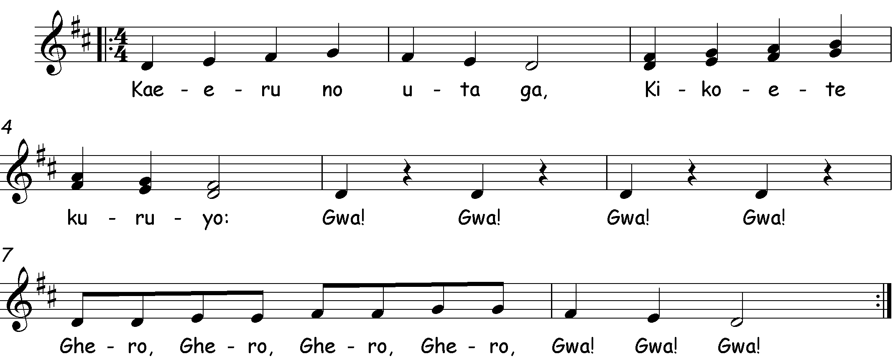
Kaeru No Uta Ga
Translation: “Listen to the frogs’ new song. You can hear it all day long”
Notes:
Although this is lyrically very challenging, it is a great song to use as an introduction to part singing. Notice how the melody goes up and down in pitch by step. Teach the upper pitches of the second phrase, leaving the lower notes for an extension activity later.
Things to try:
Begin with your ‘frog chorus’ singing the “gwa (rest) gwa (rest)” phrase as an ostinato (repeating pattern) which gives the starting note for the other half of the frogs to begin singing with the melody. If you have some guiros (frog guiros would be great but are not essential), they could play the guiro at the same time as they sing ‘gwa’.
For a further extension activity:
With a group of confident singers, try to introduce the second melodic part that is a repeat of the first phrase whilst the others sing the higher pitched phrase.

Slide 35
Hear The Christmas Bells
Notes:
This is a lovely song for Christmas and the first and third phrases can be sung by a separate group as a melodic ostinato (repeating pattern)
Things to try:
Add bell-ringing movements for a pulse
Play the two ‘ding dong’ pitches on chime bars, or tuned bells if you have them. Keep it steady! Can they play with the singers? Can they play all the way through?
Explore how you want the overall mood to be and create that in your performance – is it fast, loud, gentle, slow?

Slide 36
Copyright Notice
We have made every effort to trace the copyright owners of the songs within these songbooks (with the majority of the songs being in the public domain already). If we have not acknowledged any copyrighted material, please contact us immediately.
Thank you to Rachel Thomas (Dawson) and Joan Wright, for the original Songbook 1&2 concept and content.
Many thanks to Joan Wright (formally a member of the Hertfordshire Primary Music Team) for generously letting us use her songs and adaptations of songs and lyrics – ‘Dads, Lads, Girls, Mums’; ‘Henry King of England’; and ‘Dean Bon Bean’.
Additional thanks to all of the past and current members of the Hertfordshire Music Service Primary Music Team.
We have also included a bibliography to credit the authors/publishers of the books where we sourced many of these traditional songs.

Slide 37
Have You Brought Your … Voice?
Neilson, Katie. Voices Foundation Inside Music – Early Years Ages 0-5. Published by The Voices Foundation and Alfred Publishing Co. (UK) Ltd. The Voices Foundation 2016. ©Boosey&Hawkes
Rowsell, Cyrilla and Vinden, David. Jolly Music Beginner Book. Published by Jolly Learning LTD, 2008.
Choppety Chop
Neilson, Katie. Voices Foundation Inside Music – Early Years Ages 0-5. Published by The Voices Foundation and Alfred Publishing Co. (UK) Ltd. The Voices Foundation 2016 ©Boosey&Hawkes
Geoghegan, Lucinda. Singing Games and Rhymes for Early Years. Published by the National Youth Choir of Scotland, 1999. ©Elizabeth Matterson, This Little Puffin, 1991
Rowsell, Cyrilla and Vinden, David. Jolly Music Beginner Book. Published by Jolly Learning LTD, 2008.
Hello, How Are You?
Maddocks, Andrew. Voices Foundation Inside Music – Ages 5-7. Published by The Voices Foundation and Alfred Publishing Co. (UK) Ltd. The Voices Foundation 2014 ©Boosey&Hawkes

Slide 38
Touch Your Shoulders
Neilson, Katie. Voices Foundation Inside Music – Early Years Ages 0-5. Published by The Voices Foundation and Alfred Publishing Co. (UK) Ltd. The Voices Foundation 2016 ©Boosey&Hawkes
Geoghegan, Lucinda. Singing Games and Rhymes for Early Years. Published by the National Youth Choir of Scotland, 1999.
Here I Come (Lemonade Song)
Geoghegan, Lucinda. Singing Games and Rhymes for Early Years. Published by the National Youth Choir of Scotland, 1999.
Rowsell, Cyrilla and Vinden, David. Jolly Music Level Four. Published by Jolly Learning LTD, 2019.
6. Starlight, Starbright
Maddocks, Andrew. Voices Foundation Inside Music - KS2 Aged 7-11. Published by The Voices Foundation and Alfred Publishing Co. (UK) Ltd. The Voices Foundation 2014 ©Boosey&Hawkes 1971
Skidmore, Jeffrey. Singing Playgrounds. Published by Ex Cathedra.
Geoghegan, Lucinda. Singing Games and Rhymes for Early Years. Published by the National Youth Choir of Scotland, 1999.
Rowsell, Cyrilla and Vinden, David. Jolly Music Level One. Published by Jolly Learning LTD, 2009

Slide 39
7. Ding Dong
Maddocks, Andrew. Voices Foundation Inside Music - KS2 Aged 7-11. Published by The Voices Foundation and Alfred Publishing Co. (UK) Ltd. The Voices Foundation 2014 ©Boosey&Hawkes 1971
Geoghegan, Lucinda. Singing Games and Rhymes for Middle Years. Published by the National Youth Choir of Scotland, 2005.
8. Row, Boys, Row
Geoghegan, Lucinda. Singing Games and Rhymes for Tiny Tots. Published by the National Youth Choir of Scotland, 2002.
Rowsell, Cyrilla and Vinden, David. Jolly Music Level Three. Published by Jolly Learning LTD, 2012.
9. On A Log
Geoghegan, Lucinda. Singing Games and Rhymes for Early Years. Published by the National Youth Choir of Scotland, 1999.
Rowsell, Cyrilla and Vinden, David. Jolly Music Level Four. Published by Jolly Learning LTD, 2019.

Slide 40
10. Suo Gan
Neilson, Katie. Voices Foundation Inside Music – Early Years Ages 0-5. Published by The Voices Foundation and Alfred Publishing Co. (UK) Ltd. The Voices Foundation 2016 ©Boosey&Hawkes
Maddocks, Andrew. Voices Foundation Inside Music - KS2 Aged 7-11. Published by The Voices Foundation and Alfred Publishing Co. (UK) Ltd. The Voices Foundation 2014. ©Boosey&Hawkes 1971
Geoghegan, Lucinda. Singing Games and Rhymes for Tiny Tots. Published by the National Youth Choir of Scotland, 2002.
11. Pease Pudding Hot
Maddocks, Andrew. Voices Foundation Inside Music - KS2 Aged 7-11. Published by The Voices Foundation and Alfred Publishing Co. (UK) Ltd. The Voices Foundation 2014 ©Boosey&Hawkes 1971
Neilson, Katie. Voices Foundation Inside Music – Early Years Ages 0-5. Published by The Voices Foundation and Alfred Publishing Co. (UK) Ltd. The Voices Foundation 2016. ©Boosey&Hawkes 1971
Geoghegan, Lucinda. Singing Games and Rhymes for Early Years. Published by the National Youth Choir of Scotland, 1999.
Geoghegan, Lucinda and Bell, Christopher. Go for Bronze Level One Student Book and Teacher Book,. Published by the National Youth Choir of Scotland, reprinted in 2013.
Rowsell, Cyrilla and Vinden, David. Jolly Music Beginner Book. Published by Jolly Learning LTD, 2008 and 2019

Slide 41
12. What Shall We Play?
13. Engine, Engine
Geoghegan, Lucinda. Singing Games and Rhymes for Early Years. Published by the National Youth Choir of Scotland, 1999.
Rowsell, Cyrilla and Vinden, David. Jolly Music Level Two. Published by Jolly Learning LTD, 2010. ©Boosey&Hawkes
14. Bow, Wow, Wow
Maddocks, Andrew. Voices Foundation Inside Music - KS2 Aged 7-11. Published by The Voices Foundation and Alfred Publishing Co. (UK) Ltd. The Voices Foundation 2014 ©Boosey&Hawkes
Geoghegan, Lucinda. Singing Games and Rhymes for Early Years. Published by the National Youth Choir of Scotland, 1999.
Erdei, Peter (editor). 150 American Folk Songs to Sing, Read and Play. Published by Boosey and Hawkes, 1974 ©Boosey&Hawkes
Rowsell, Cyrilla and Vinden, David. Jolly Music Level Three. Published by Jolly Learning LTD, 2012.
Rowsell, Cyrilla and Vinden, David. Jolly Music Level Four. Published by Jolly Learning LTD, 2019.

Slide 42
15. Little Johnny Dances
Geoghegan, Lucinda. Singing Games and Rhymes for Tiny Tots. Published by the National Youth Choir of Scotland, 2002.
16. Funmje Alafia
17. Step Back Baby
Geoghegan, Lucinda. Singing Games and Rhymes for Early Years. Published by the National Youth Choir of Scotland, 1999.
Rowsell, Cyrilla and Vinden, David. Jolly Music Level Four. Published by Jolly Learning LTD, 2019.
18. Un Eléphant
19. Oo A Lay Lay
Maddocks, Andrew. Voices Foundation Inside Music - KS2 Aged 7-11. Published by The Voices Foundation and Alfred Publishing Co. (UK) Ltd. The Voices Foundation 2014. ©Boosey&Hawkes
Hunt, Peter. Voiceworks: A Handbook for Singing Book 1. Published by Oxford University Press, 2001.
Kaeru No Uta Ga
Hear The Christmas Bells

